Slide 1
Algorithm and their application
Assignment # 3
CSE 2020314303 박진덕

Slide 2
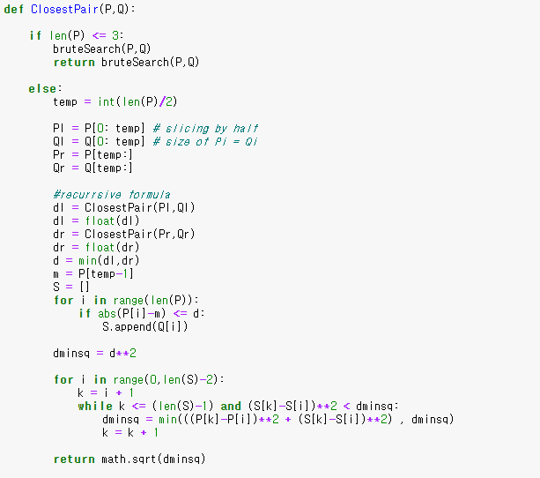
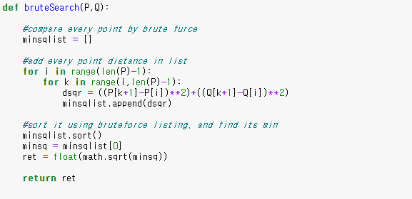
1. Closest pair
Source code
Closest Pair method
Brute search method
Brute force for len(P)<=3
Split x,y coordinate
Recursive formula for closestPair

Slide 3
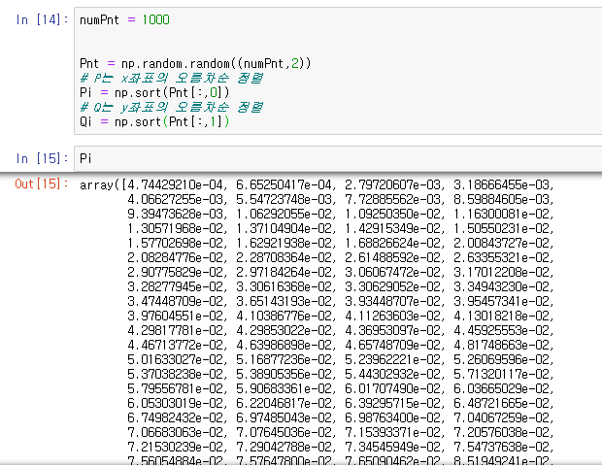
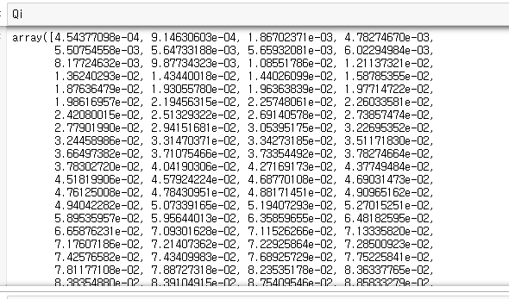
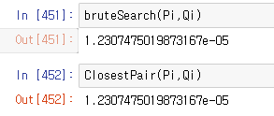
1. Closest pair
Implementation
Input
Result : return minimum distance

Slide 4
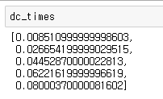
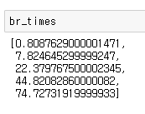
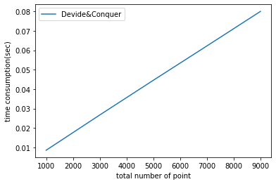
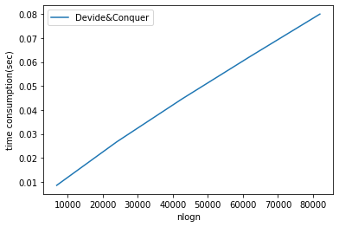
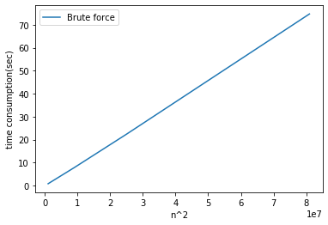
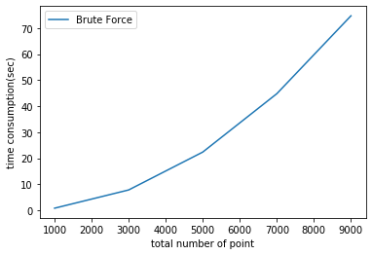
1. Closest pair
(a), (b)
Time consumption for n = 1000, 3000, 5000, 7000, 9000 each
* 5 times measure
<Devide&Conquer>
n = total # of points
Time complexity plot: It is suffice to see time consumption linearly increase with nlogn x-scale,
But it was O(n), not O(nlogn)
x axis: nlogn
<Brute Force>
Time complexity plot: It is suffice to see time consumption linearly increase with n**2 x-scale,
We can see O(n**2) of brute force algorithm.
x axis: n**2

Slide 5
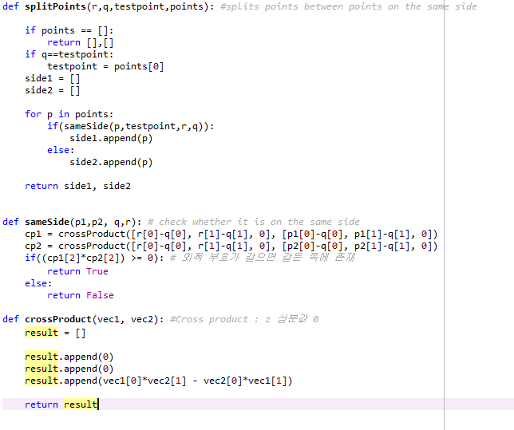
2. Convex hull
Triangles. py
Method for split points to two sides
Method for checking whether the two points are same side or not
Cross product for method sameSide()

Slide 6
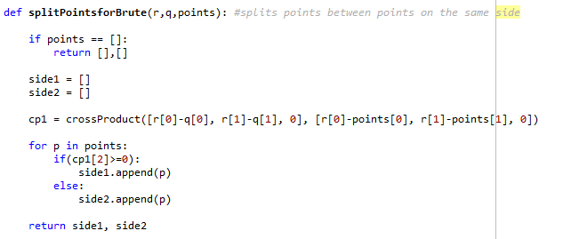
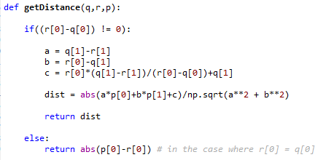
2. Convex hull
Triangles. py
Split 2 side method for brute force alg using crossProduct sign
Distance measuring method with line (qr), measuring point p

Slide 7

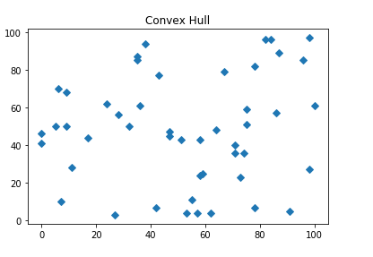

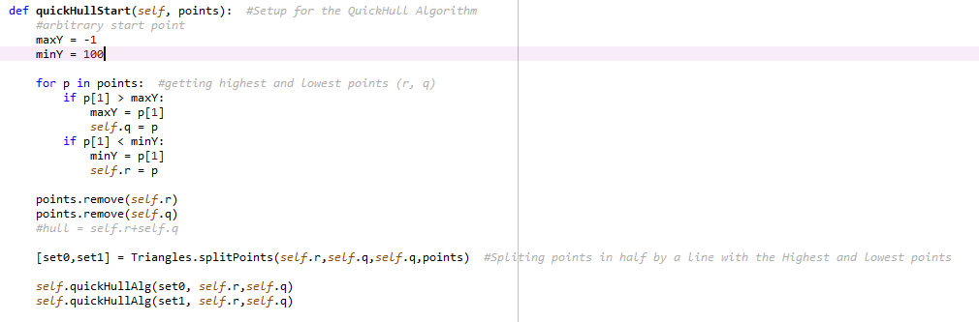
2. Convex hull – quick hull
Class ConvexHull to implement ‘quickhull’
Contents below are method of Class ConvexHull.
Add input points as list
Starting quickhull with finding farthest two point
Start recursion with quickHull algorithm

Slide 8
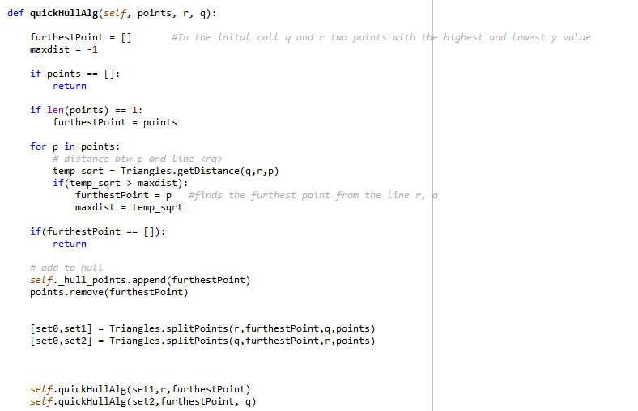
2. Convex hull – quick hull
Compare each point to find furthest one.
Add farthest point in set to hull_point
Split two part again.
Recursively add hull points

Slide 9
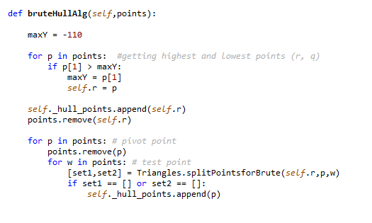
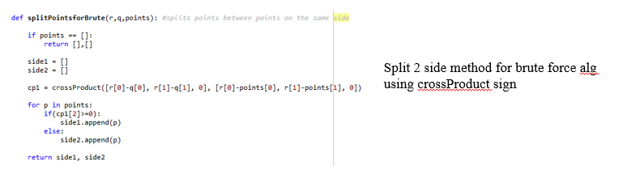
2. Convex hull – brute force
Arbitrary select one minimum hull point
Compare all the points iterate way 2 times.
If either side is empty, append hull point.

Slide 10
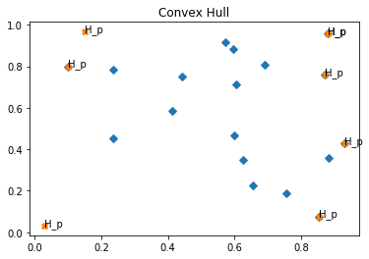
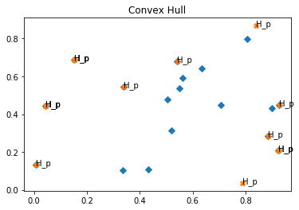
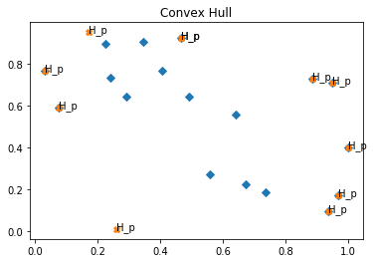
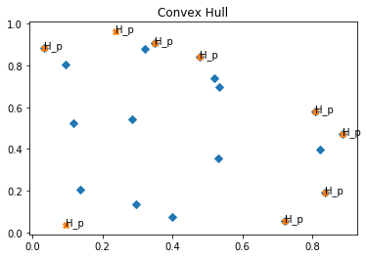
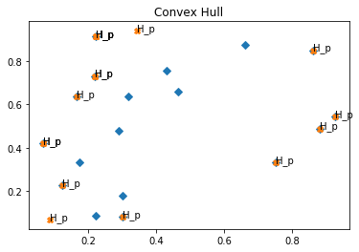
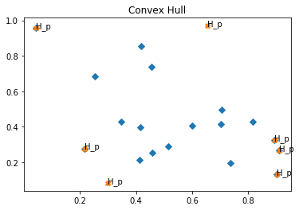
2. Convex hull
Visual Results of Alg with # of points = 20

Slide 11

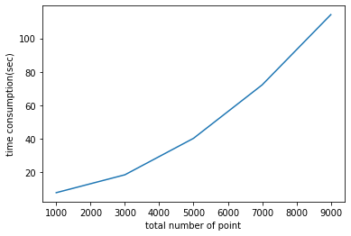
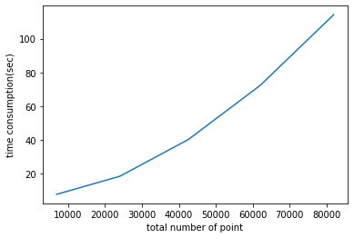
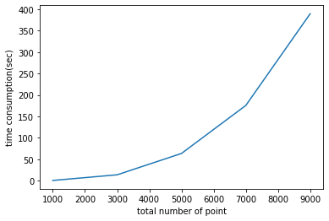
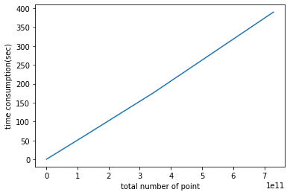
2. Convex hull
(a), (b)
Time consumption for n = 1000, 3000, 5000, 7000, 9000 each
* 5 times measure
<Devide&Conquer>
n = total # of points
Time complexity plot: It is suffice to see time consumption linearly increase with nlogn x- scale,
But It does not seem to be linear even if we change x-scale to nlogn scale
x axis: nlogn
<Brute Force>
Time complexity plot: It is suffice to see time consumption linearly increase with n**3 x- scale,
We can see O(n**3) of brute force algorithm.
x axis: n**3

